Slide 1

Distributing a (Linux) native application with
penMOLE

Slide 2
Prerequisite
You should have:
- OpenMOLE (5.4)
- A Linux computer
(to practice packaging)
- Python

Slide 3
Get the archives
Go to www.openmole.org/files/csdc
Get packaging.tgz and Native.tgz

Slide 4
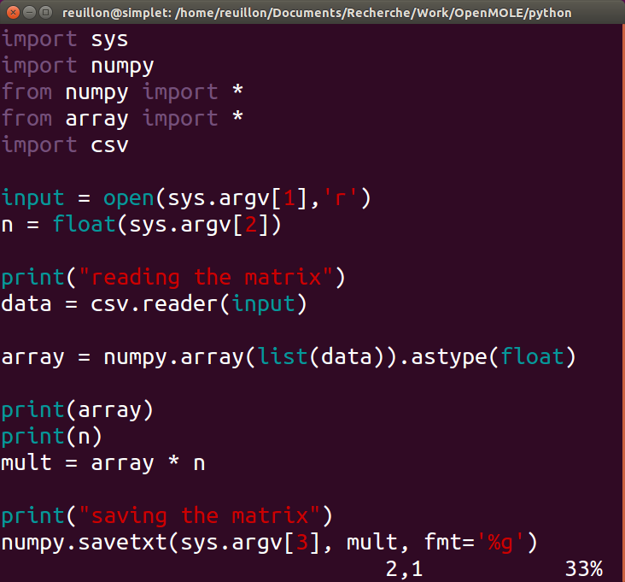
A native application
Content of “matrix.py”

Slide 5
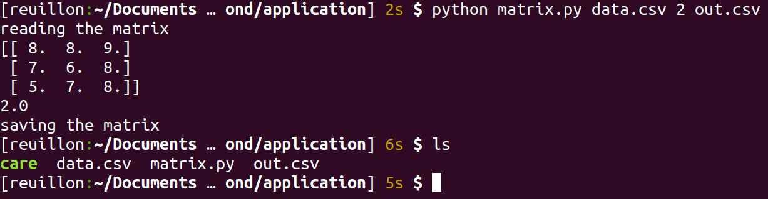
Run it
Reads data.csv
Multiply it by 2
Write out.csv

Slide 6
Make it portable
This application depends on:
- python
- numpy
- libc…
The solution: use CARE
http://reproducible.io/

Slide 7
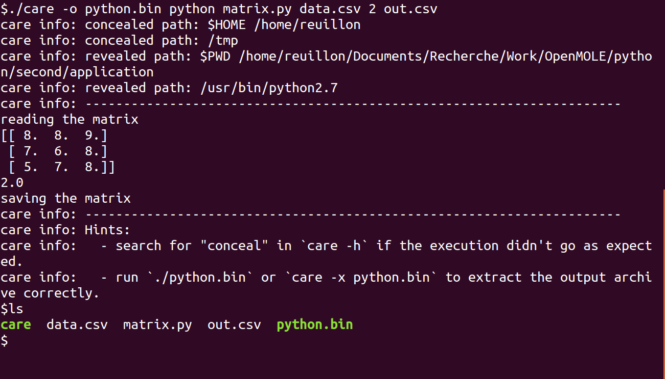
Make it portable

Slide 8
Make it portable
What is python.bin?
- An auto-extractible archive
- Contains every single files accessed by the program (and a bit more)
How do I use it?
- Extract: ./python.bin
- Run: ./python/re-execute.sh

Slide 9
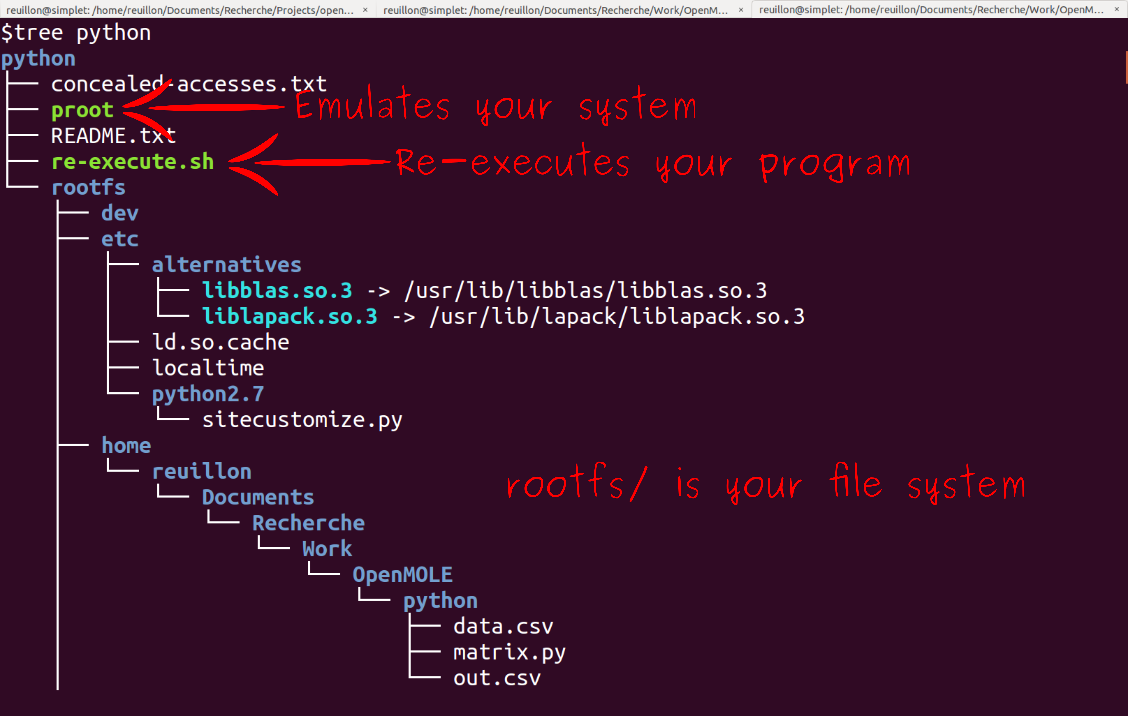
Make it portable
What's inside python.bin?

Slide 10
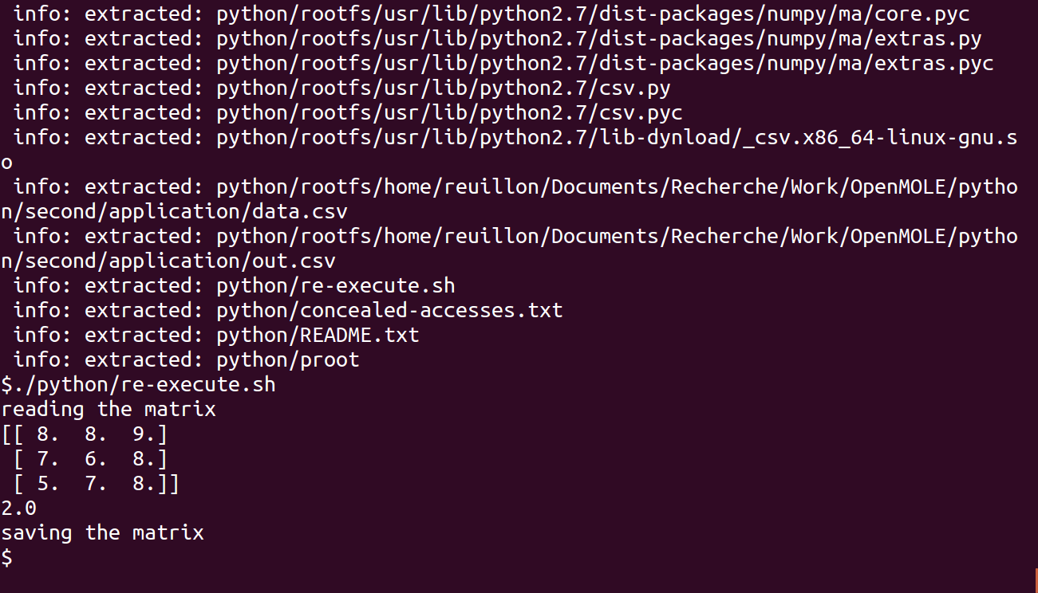
Make it portable
It will work on any other Linux machine

Slide 11
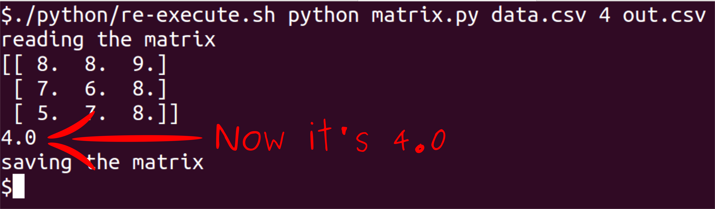
Make it portable
And you can change the parameters

Slide 12
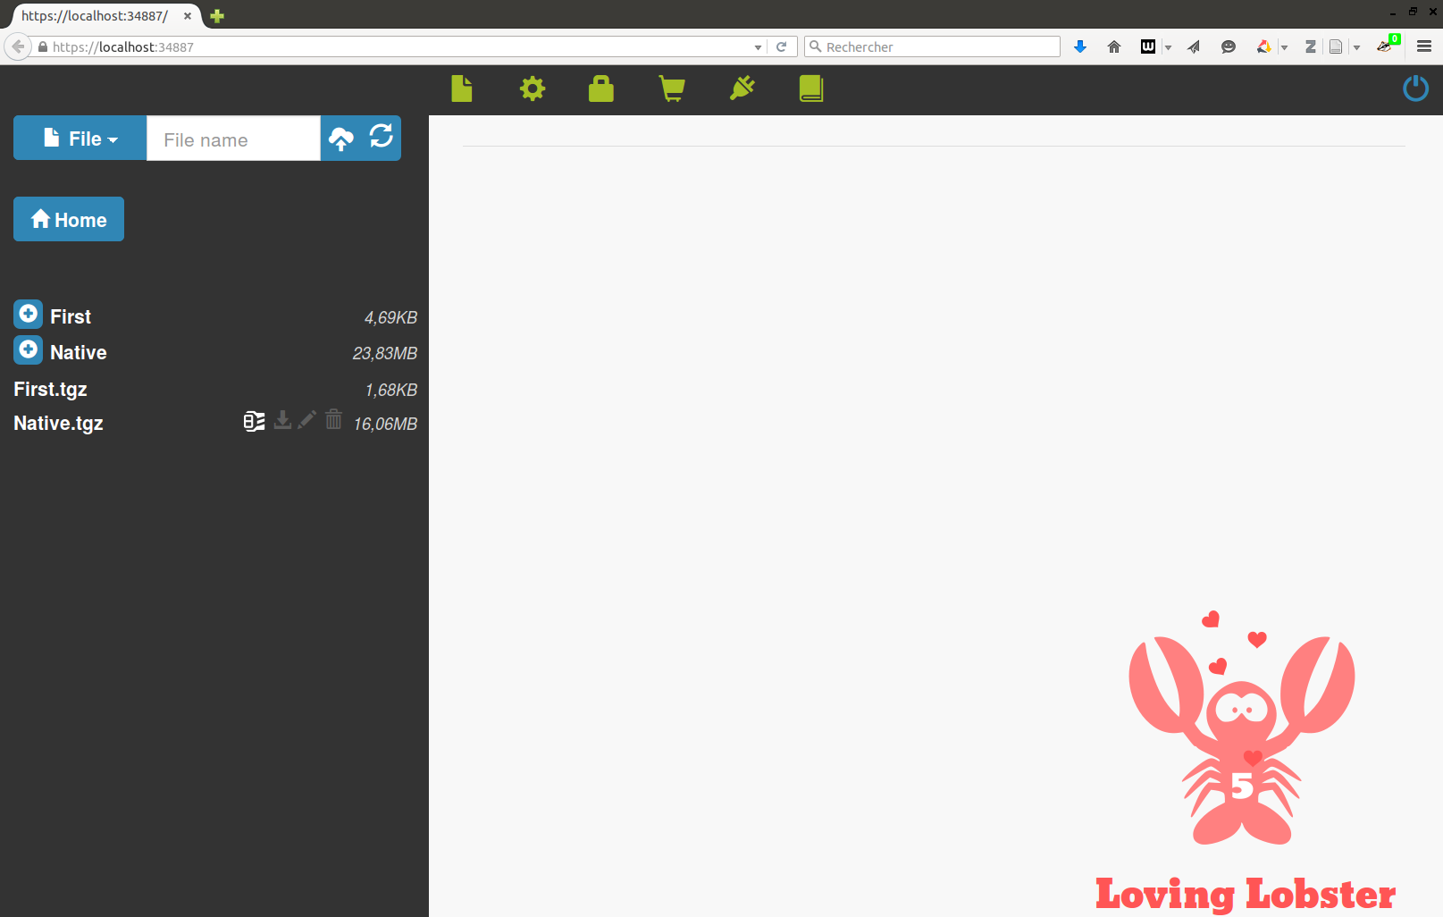
Run it in OpenMOLE
Launch OpenMOLE, upload native.tgz and extract it.

Slide 13
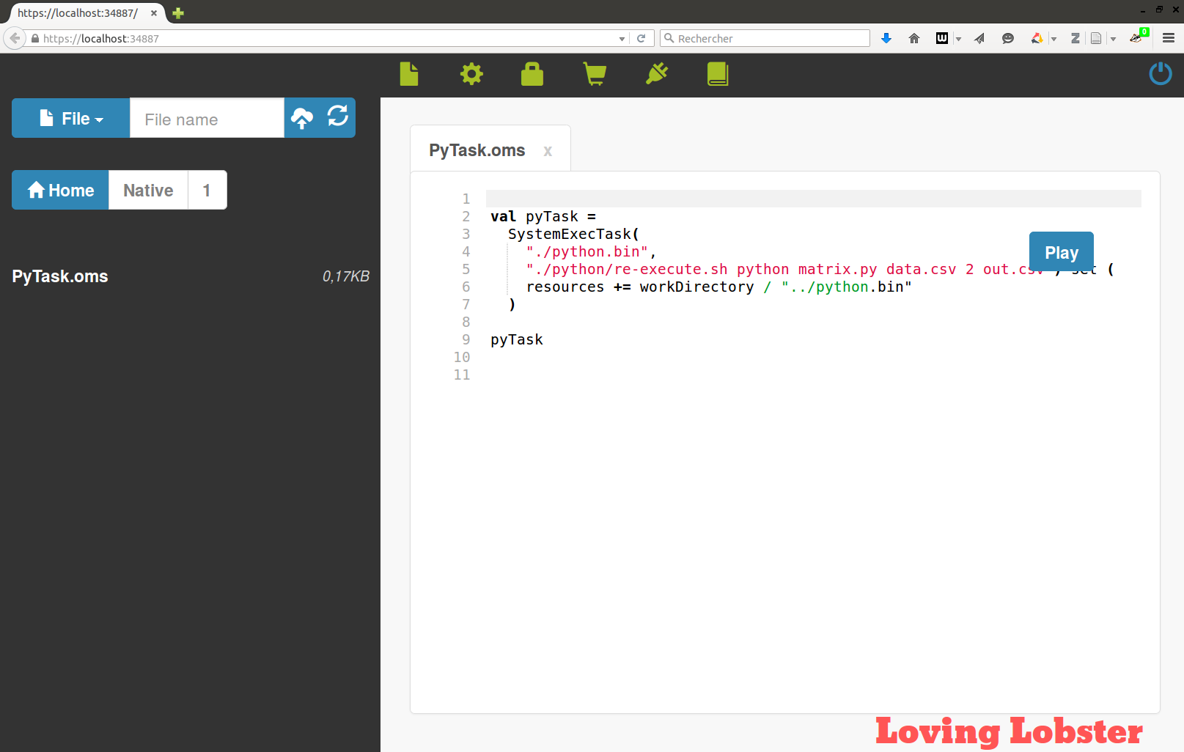
Run it in OpenMOLE
Go to “Native/1” and edit PyTask.oms

Slide 14
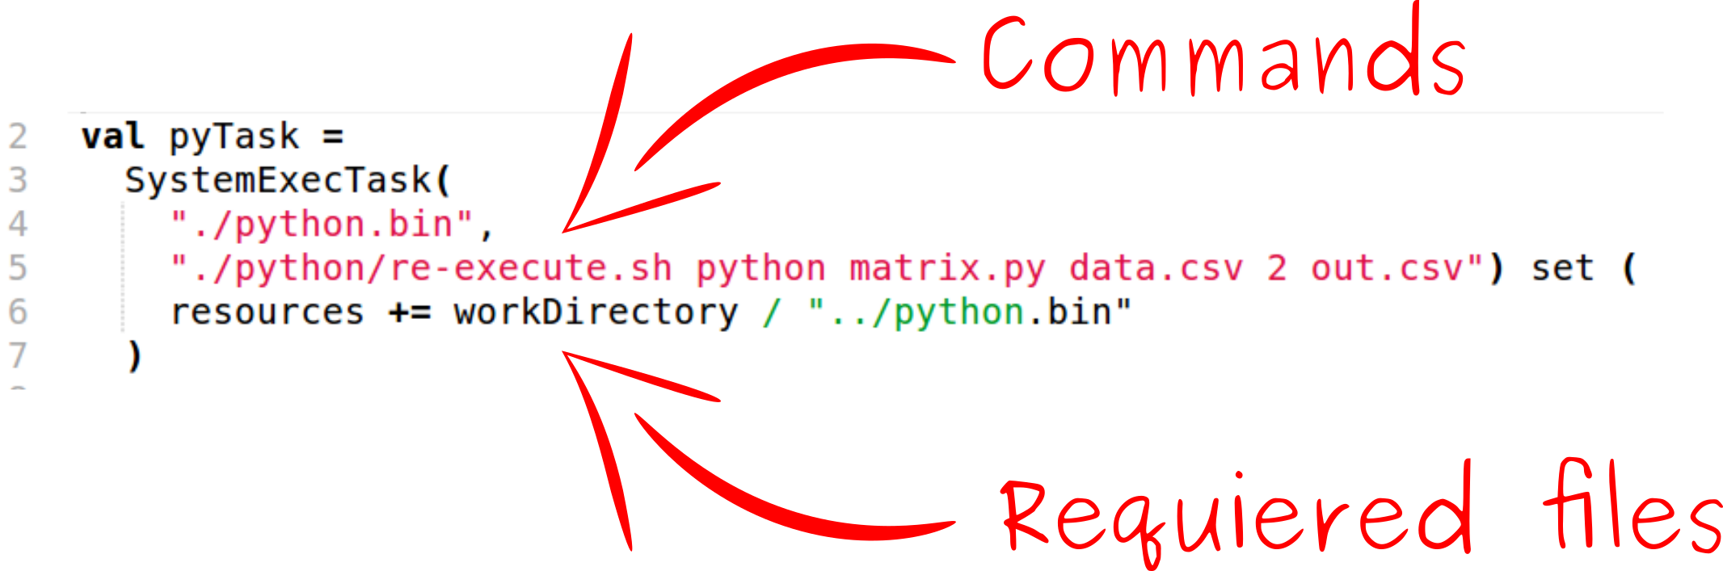
Run it in OpenMOLE
Use a SystemExecTask:

Slide 15
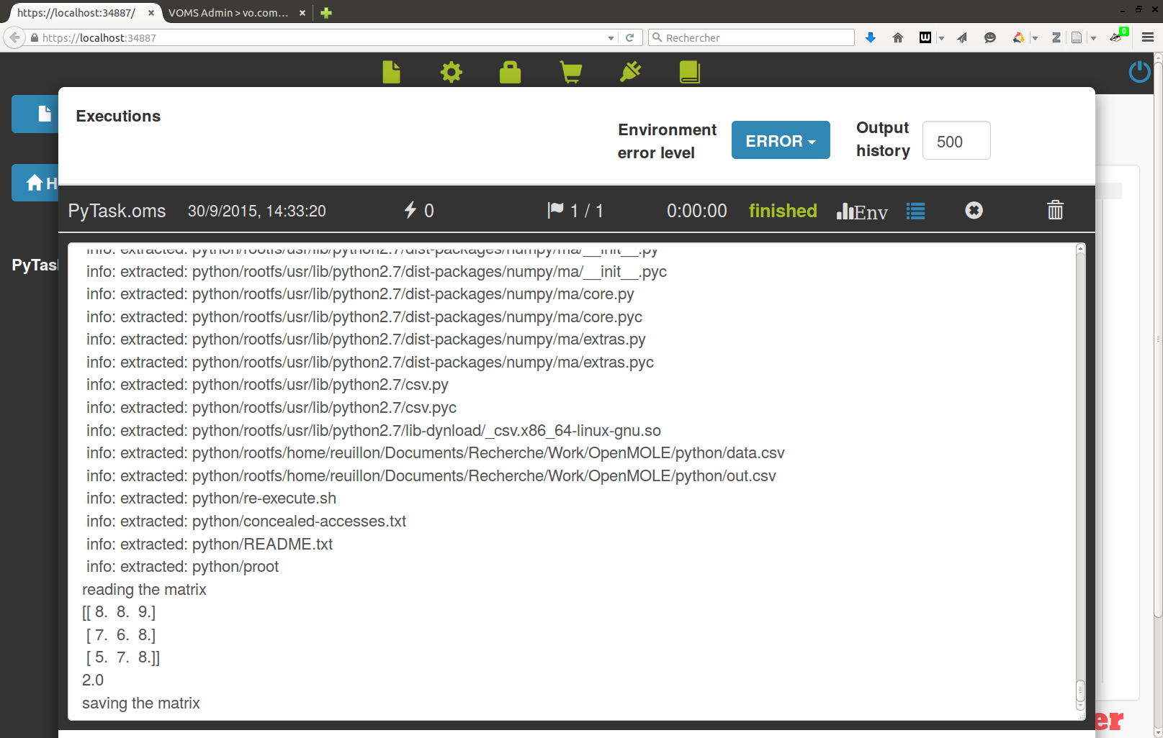
Run it in OpenMOLE

Slide 16
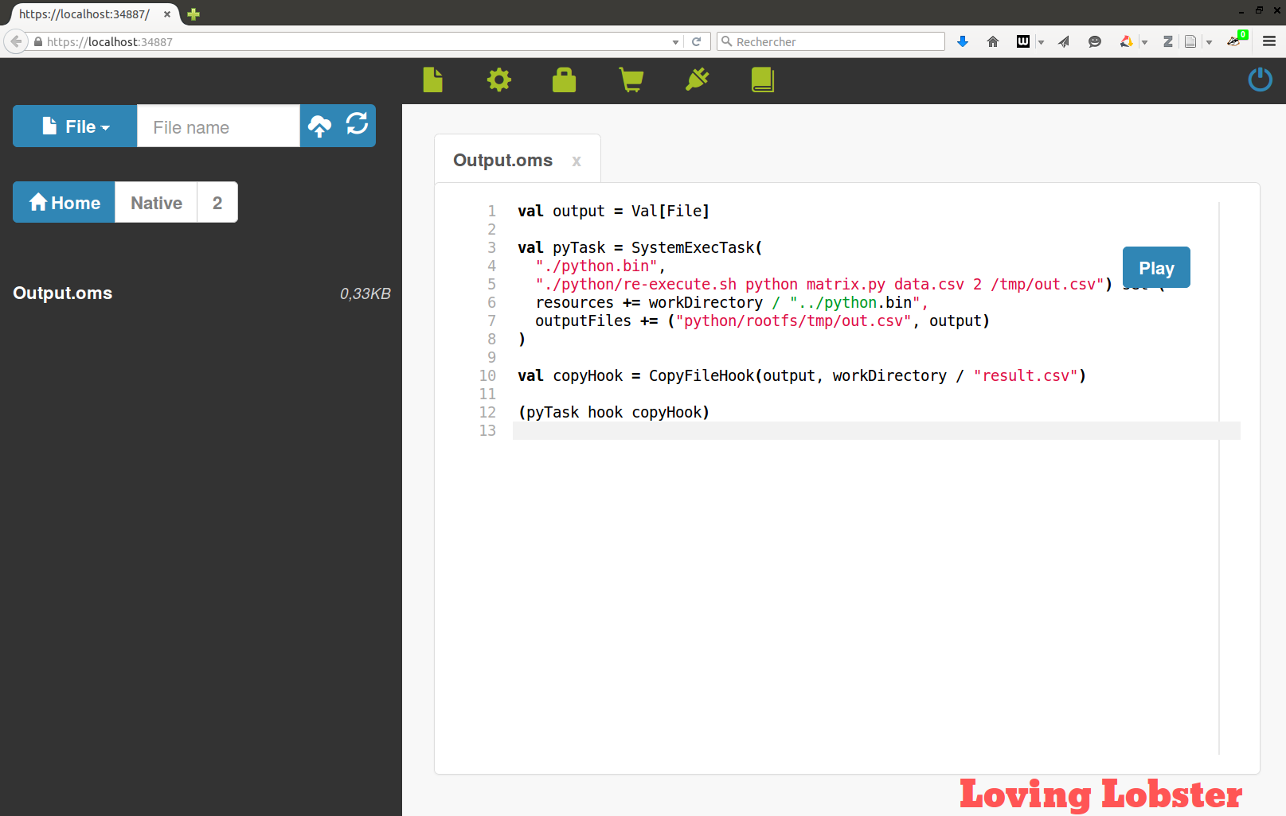
Get the output file
Go to “2” and edit Output.oms

Slide 17
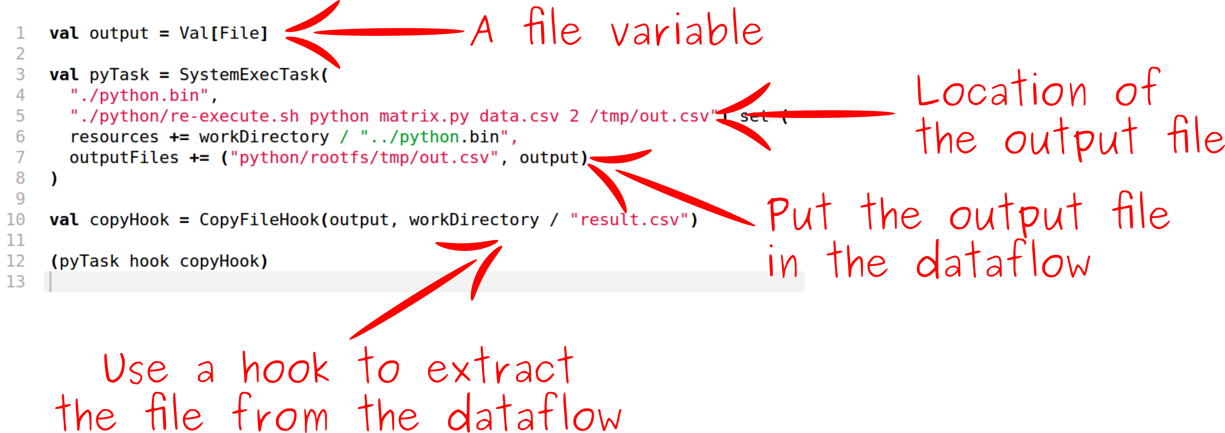
Get the output file

Slide 18
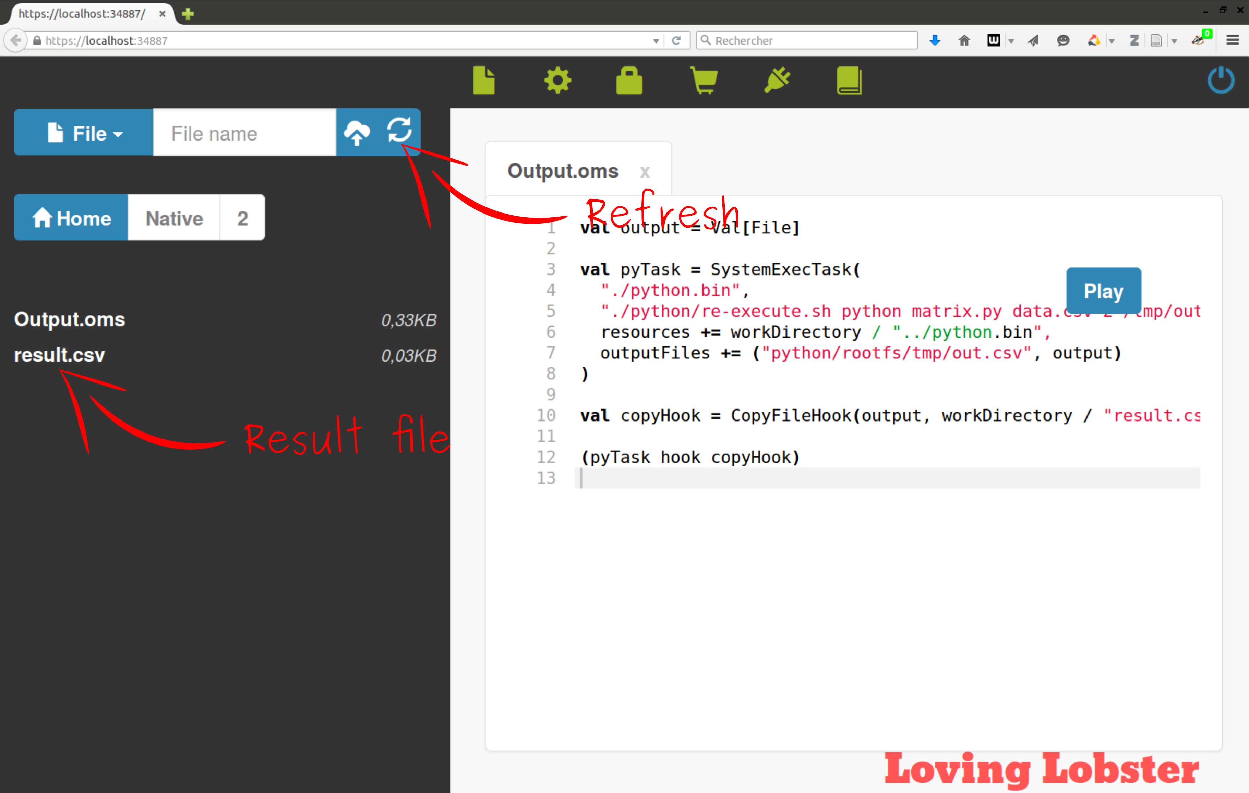
Get the output file
Run it and refresh.

Slide 19
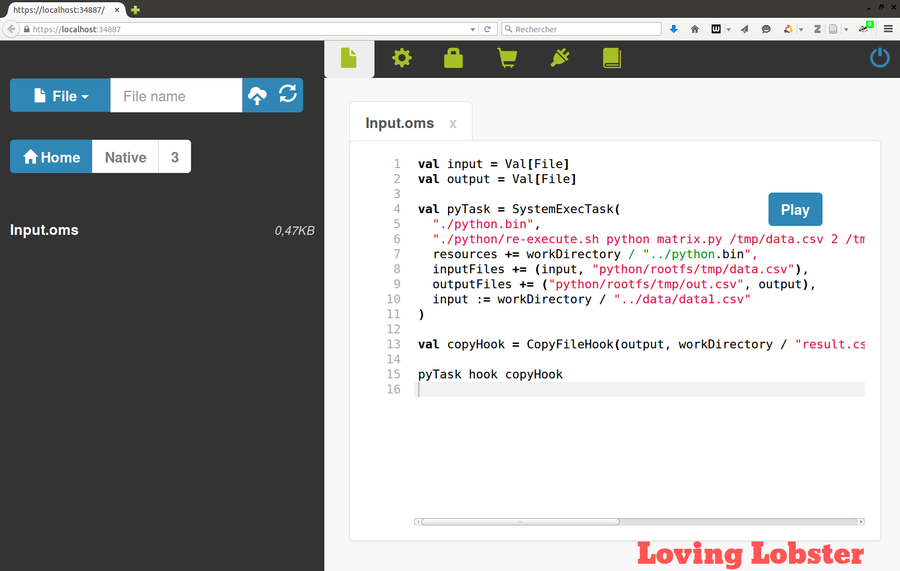
Inject an input file
Go to “3” and edit Input.oms

Slide 20
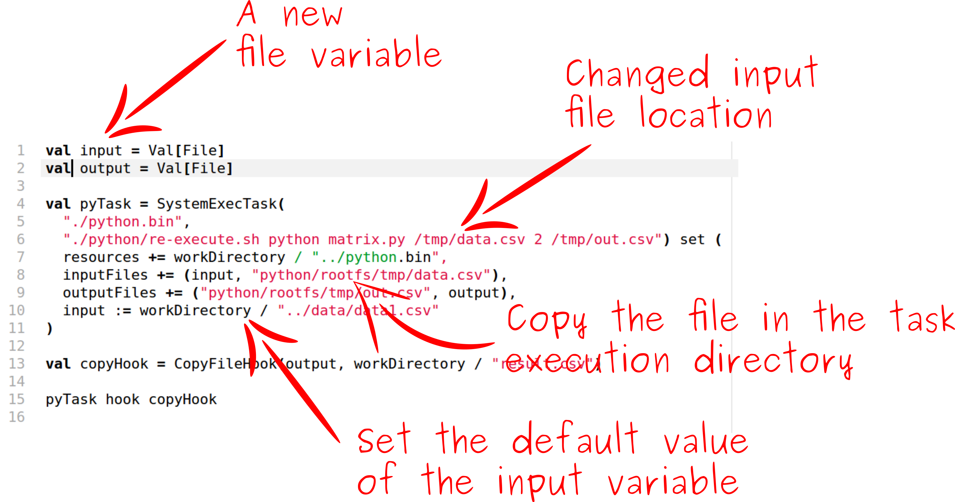
Inject an input file

Slide 21
Inject an input file
Run it!
You can change the file manually:
  data1.csv
  data2.csv
  data3.csv

Slide 22
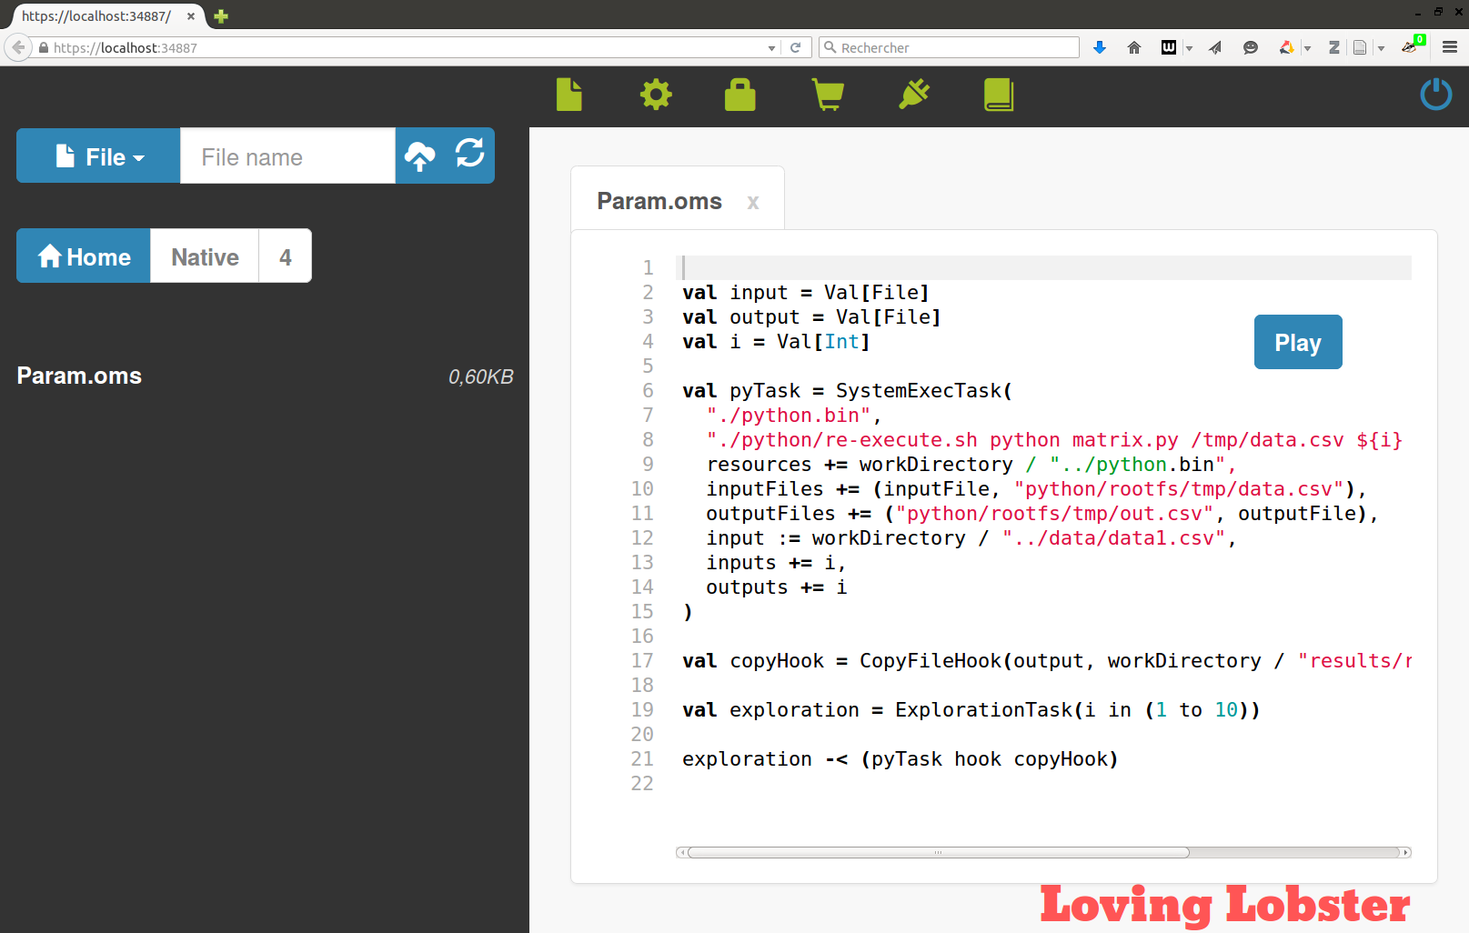
Explore a parameter
Go to “4” and edit Param.oms

Slide 23
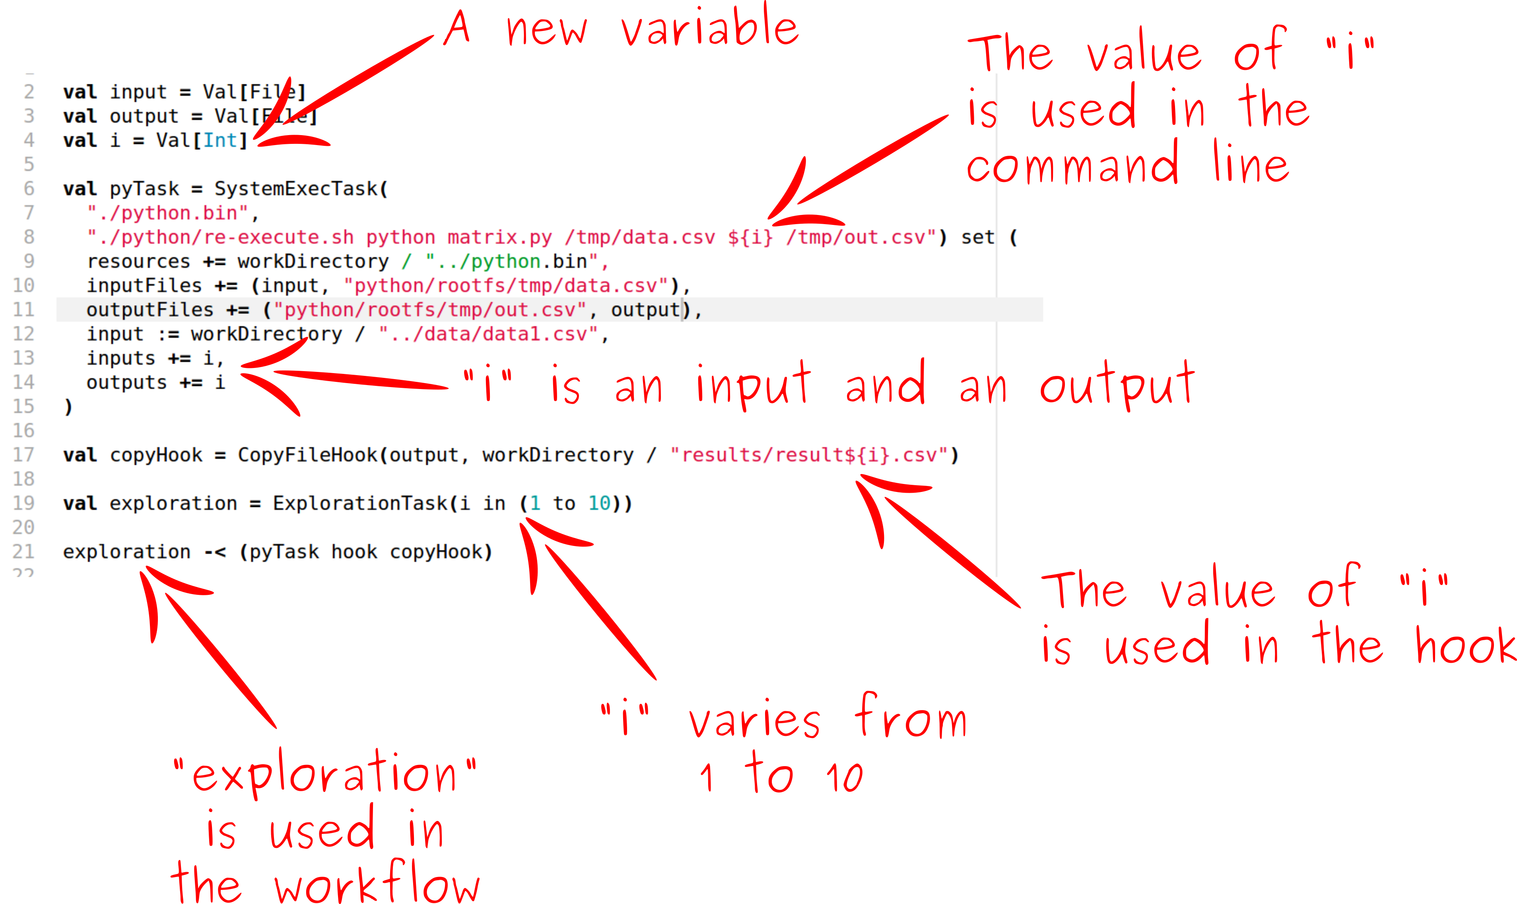
Explore a parameter

Slide 24
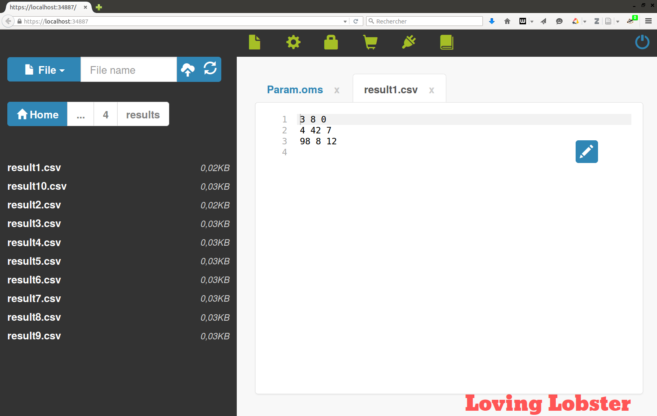
Explore a parameter
Run it, refresh and go to “results” folder.

Slide 25
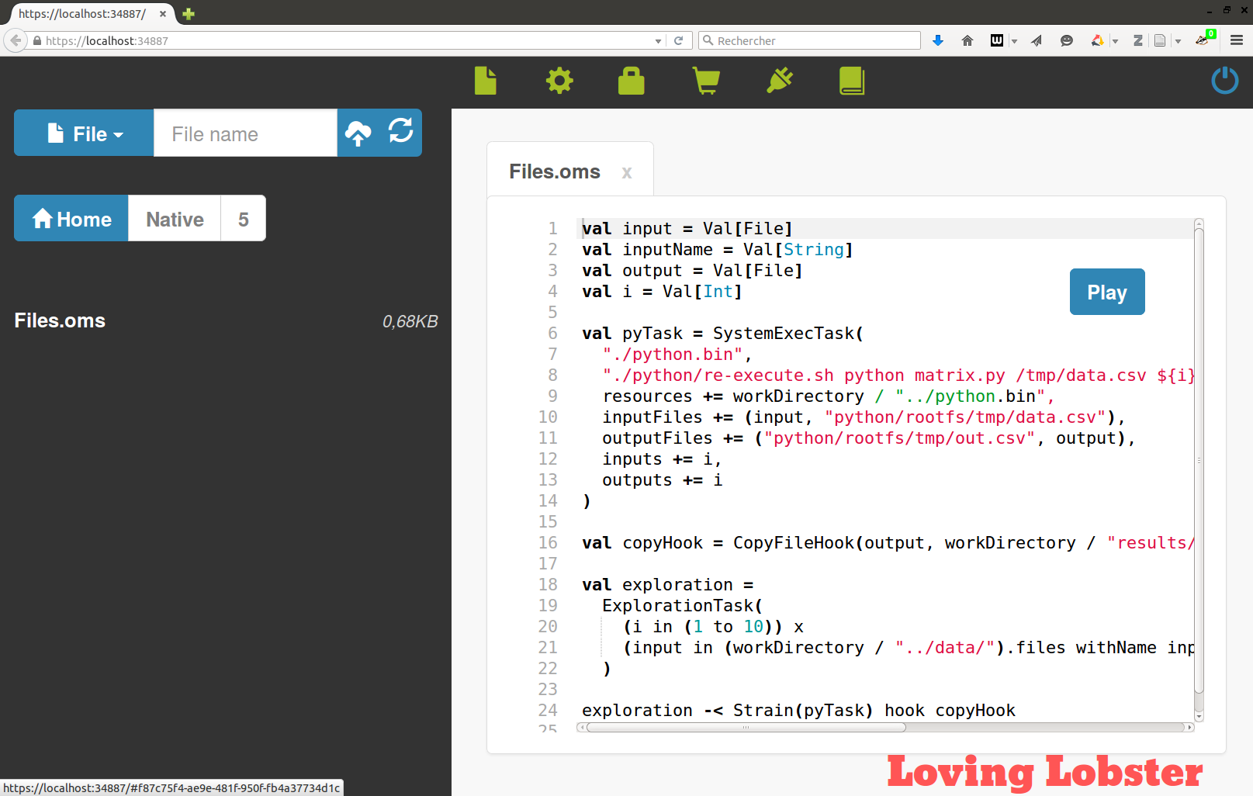
Explore the input file
Go to “5” and edit Files.oms

Slide 26
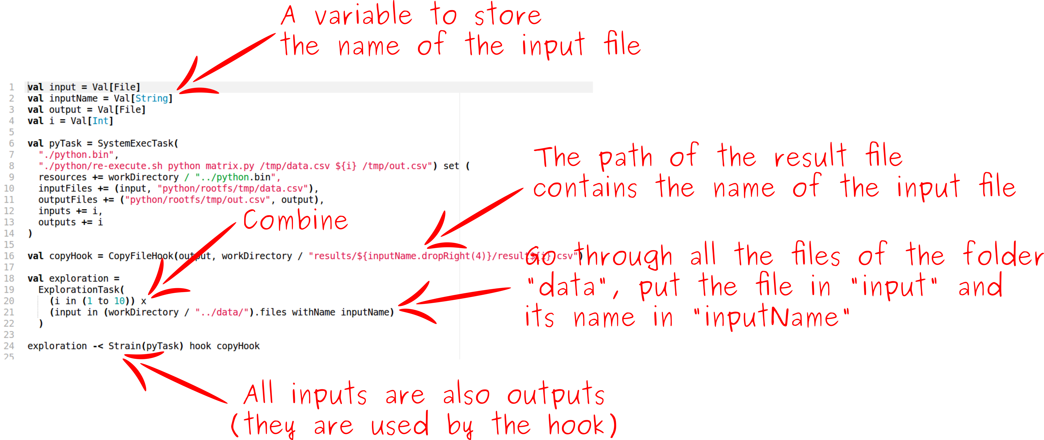
Explore the input file

Slide 27
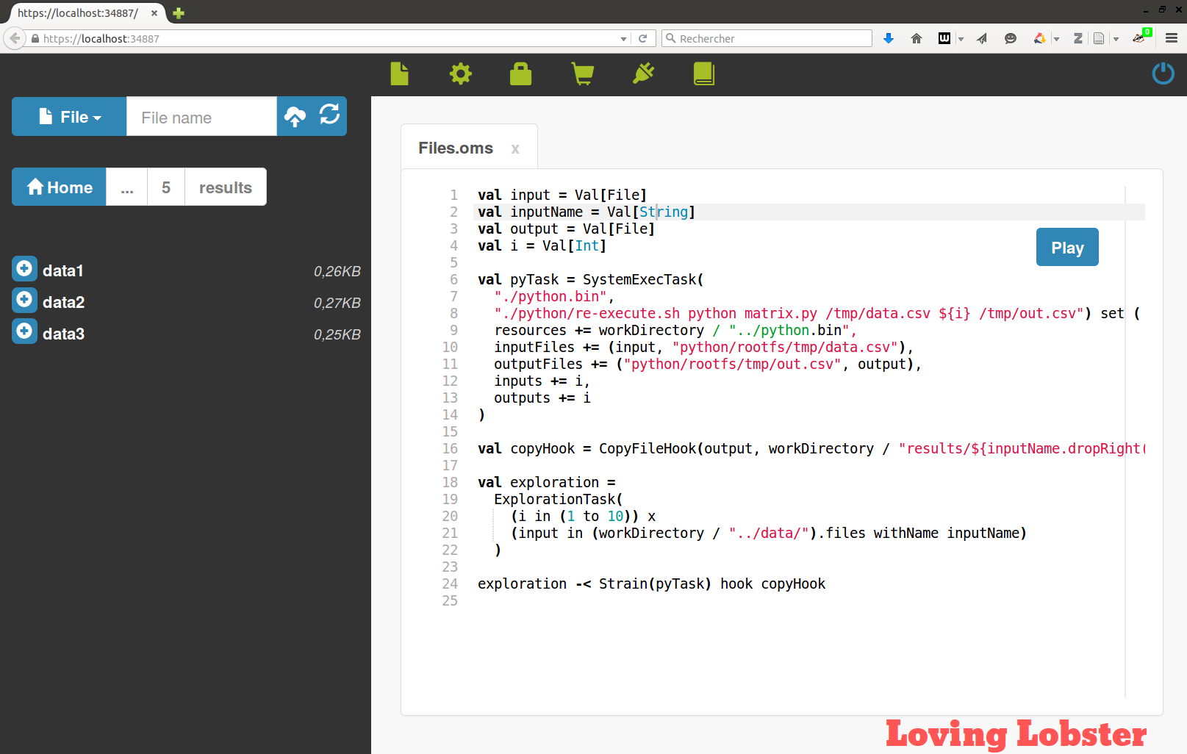
Explore the input file
Run it and go in the “results” folder.

Slide 28
Delegate to the Grid
The complex-systems propose 5000+ cores of computing for researchers.
Go to: http://iscpif.fr/vo/ to learn how to access it.

Slide 29
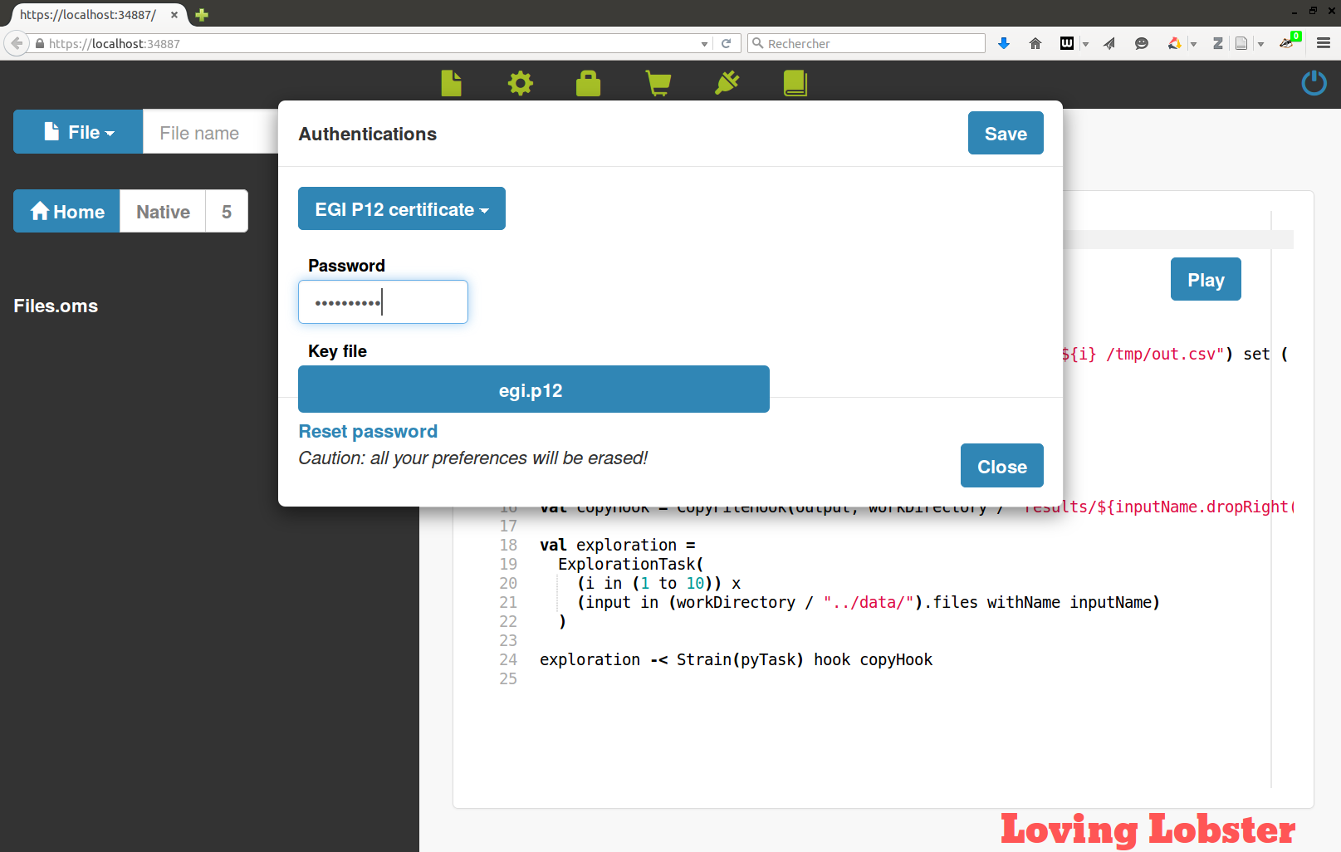
Delegate to the Grid
Configure OpenMOLE

Slide 30

Delegate to the Grid
Add one line to the script

Slide 31
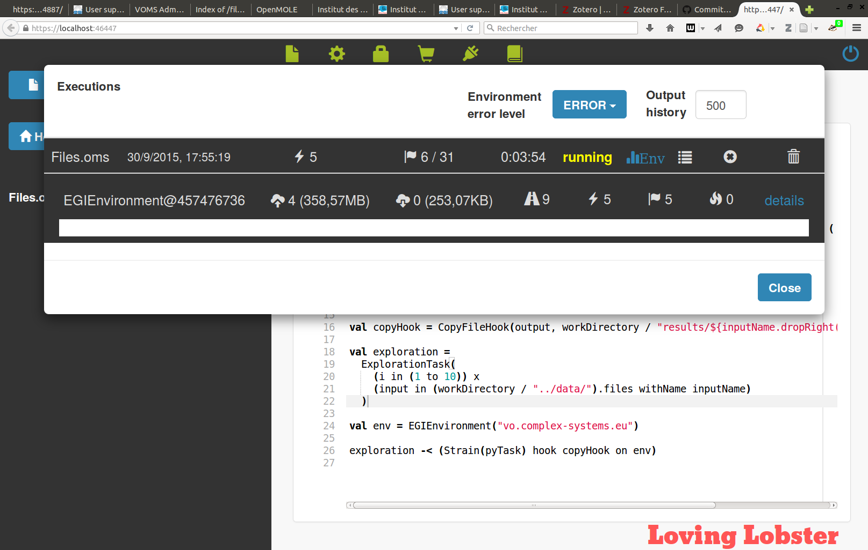
Delegate to the Grid
It runs!

